Slide 1


Slide 2
Presented by:2nd year Engineering students
(AI-ML) Div : A
TEAM MEMBERS PRN NO
1. 25UME044-Ganesh Ujesh Raut
2. 25UAM065-Abhishek Ajit Shirguppe
3. 25UAM069-Sanket Subhash Patil
4. 25UAM043-Atharv Chandrashekhar Kagale
5. 25UAM017-Saad Aslam Maner

Slide 3
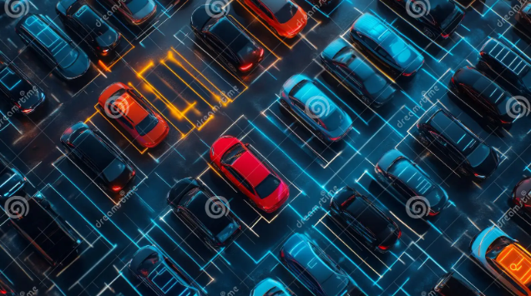
INTRODUCTION
A Smart Parking Management System is a system that helps drivers find empty parking spaces quickly. It uses sensors and IoT technology to detect vacant parking slots and show the information on a display or mobile app. This saves time, fuel, and reduces traffic congestion.

Slide 4
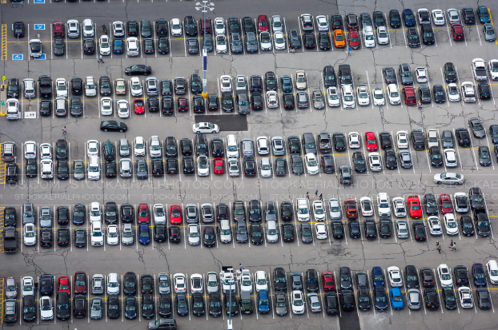
Problem Statement
Drivers spend a long time searching for empty parking spaces.
Traffic congestion increases around parking areas.
Fuel is wasted while looking for parking.

Slide 5

Objectives
Detect vacant and occupied parking spaces automatically.
Guide drivers to the nearest available parking slot.
Save fuel, time, and energy.
Support the development of smart cities.

Slide 6
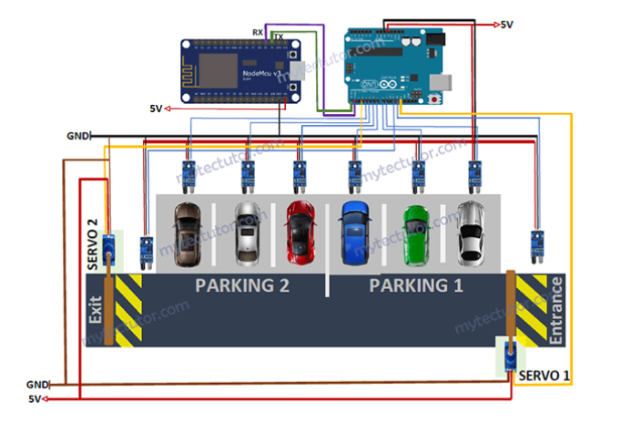
Components Used
Arduino Uno / ESP32
Ultrasonic Sensors
Servo Motor
LCD Display
Arduino IDE
Cloud Database

Slide 7
Working Principle
A vehicle enters the parking area.
Ultrasonic sensors detect whether each parking slot is occupied or vacant
The controller processes the sensor data.
Information is sent to the cloud through Wi-Fi.
The available parking spaces are displayed on an LCD screen or mobile application.
Drivers are guided to the nearest vacant parking space.

Slide 8

Advantages
Reduces traffic congestion.
Saves fuel and travel time.
Provides real-time parking updates.
Reduces air pollution.
Easy to operate and maintain.
Improves parking space utilization.

Slide 9
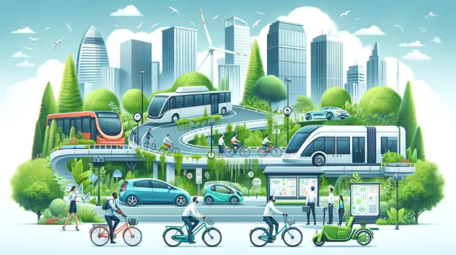
Social and Environmental Impact
Reduces unnecessary vehicle movement inside parking areas.
Helps decrease fuel consumption and air pollution.
Saves valuable time for drivers.
Improves traffic management in crowded areas.

Slide 10
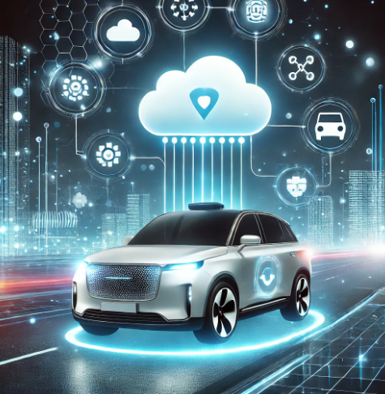
Future Scope
AI-based parking prediction.
Automatic number plate recognition (ANPR).
Online parking reservation.
Digital payment integration.
EV charging station management.

Slide 11
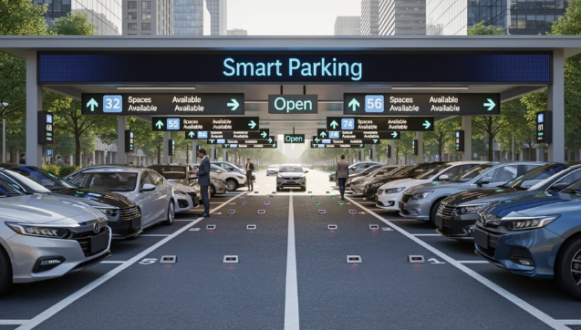
Conclusion
The Smart Parking Management System makes parking easier and faster. It helps drivers find empty parking spaces, saves time and fuel, and reduces traffic. It is a useful solution for better parking management in smart cities.

Slide 12


